Slide 1
Roadmap
Security Model
Ecosystem, Reference implementations, etc.
Application-TEE, Confidential Compute, and Capabilities-Based (AP-TEE)
AP-TEE TG + Cap-based TG(?)
Lightweight TEE
Pointer Masking (J extension)
Memory Tagging
Control Flow Integrity (CFI)
CFI TG(s): Temporal Fencing, and others
Blockchain whitepaper
International Scalar Crypto
Scalar Crypto
Vector Crypto
PQC Crypto
IOMMU within Software HC
IOMMU
S-mode MPU
ePMP
IOPMP
Microarchitectural Side Channel (uSC) leakage mitigations
uSC TG(s)
2021
2022
2023
SIG work
TG work
HC work

Slide 2
Current documents for review/ collaboration
1. RISC-V Platform Security Model
https://docs.google.com/document/d/1TRHhsGiB5W4K8M7I4e-f40mOPErTb9sv/edit?usp=sharing&ouid=115665052574408264138&rtpof=true&sd=true 2. RISC-V AP-TEE (TEE VM and Application workloads) Ref. Arch and Interface Proposal
https://github.com/riscv-admin/trusted-computing/blob/main/specifications/AP-TEE/For%20External%20-%20HW-Attested%20Scalable%20TEE%20proposal%20for%20RISC-V.adoc
https://docs.google.com/document/d/1TXiuy4ac3hQmEKvtTtM5aFVHLnNKCrYxeRZFYPRq2Xw/edit#heading=h.9yggln8khyd0
3. RISC-V Confidential VM Proposal
https://docs.google.com/document/d/1ME7THEF9JWuFqwm75x586y3wzhPeXahK8keLcgjZYG8/edit#heading=h.rdbq3ygwk878

Slide 3
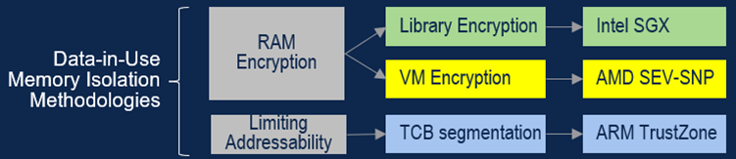
Agenda
1. CCC.io
Terminology - https://docs.google.com/document/d/1xZ6IX0w0jaWDbLMFNAybTF3FpLnQ5TJ98nzIWbsbFnY/edit
Review comments?
2. Data in use memory isolation methods
How do we share data among various confidential entities?
Transcrypt?
New crypto ISA?
Zero Trust
If we rely on RAM encryption this will be challenging
Should we consider L1/L2 level encryption? Its uArch level and not ISA level but maybe something to investigate
Security Model, AP-TEE and CVM updates

